Slide 1
Deep Canonical Correlation Analysis
Gwangwoo Kim
Mar. 24, 2023

Slide 2
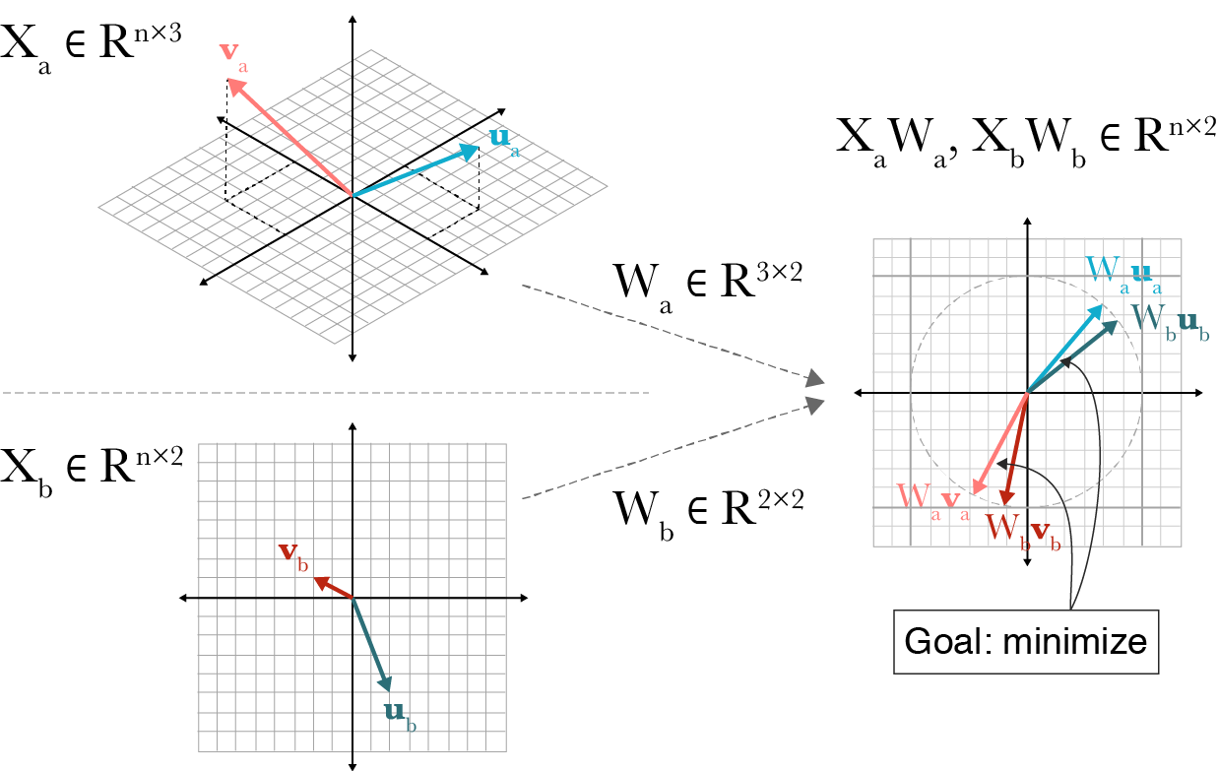
Introduction

Slide 3
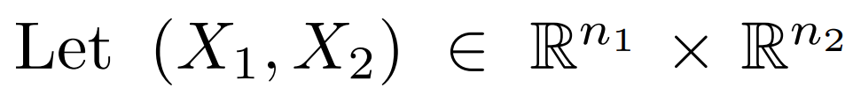
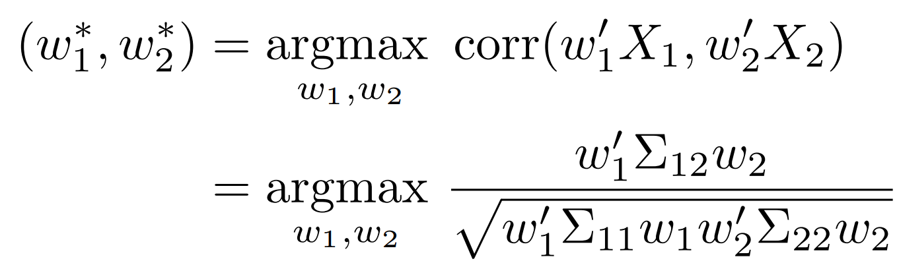
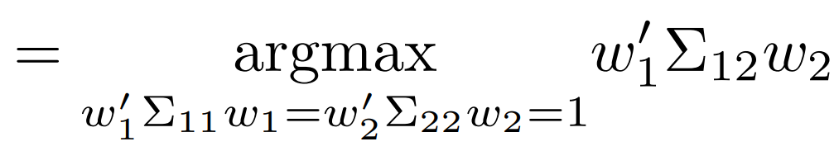
Background: Canonical Correlation Analysis (CCA)

Slide 4
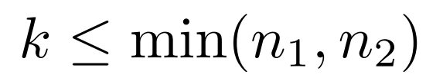
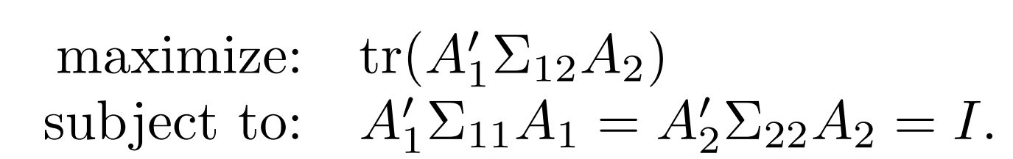
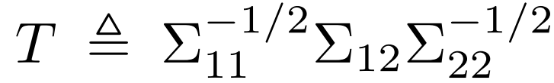
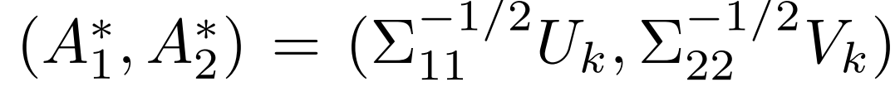
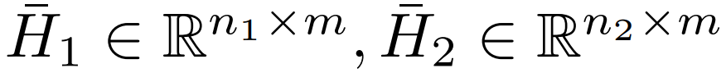
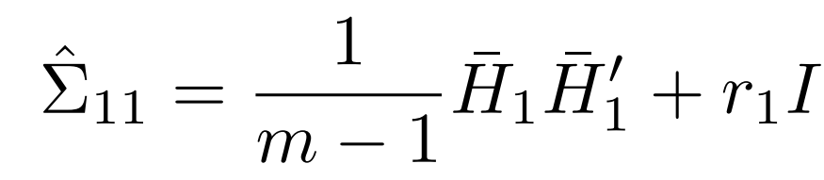
Background: Canonical Correlation Analysis (CCA)
For
Solution:
where U, V are the matrices of the first k left- and right- singular vectors of T
Estimation: Given centered data matrices , one can estimate, for example,

Slide 5
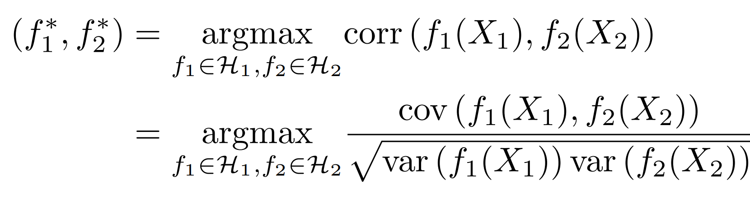
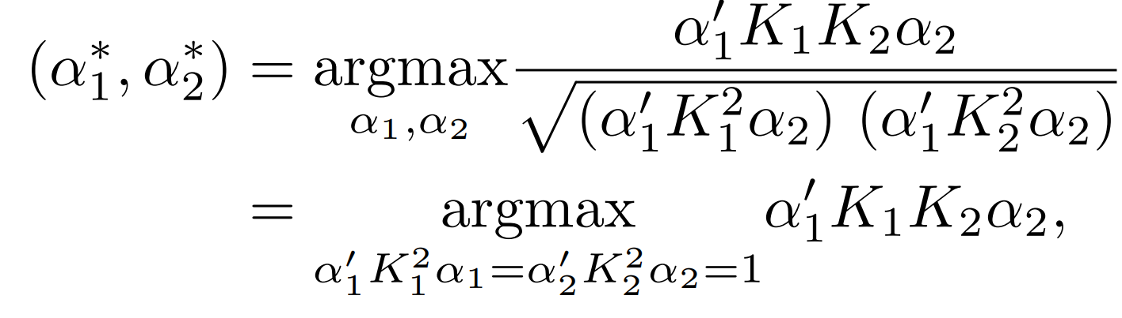

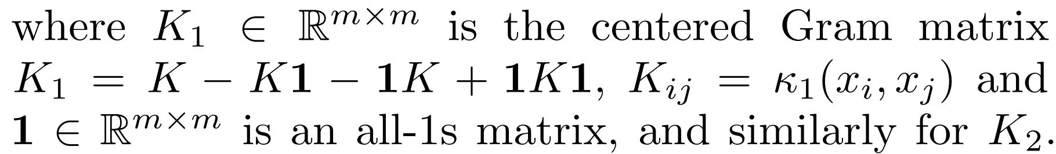
Background: Kernel CCA (KCCA)

Slide 6
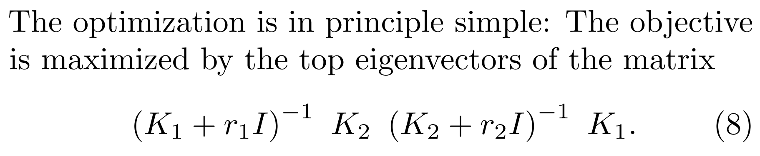
Background: Kernel CCA (KCCA)

Slide 7
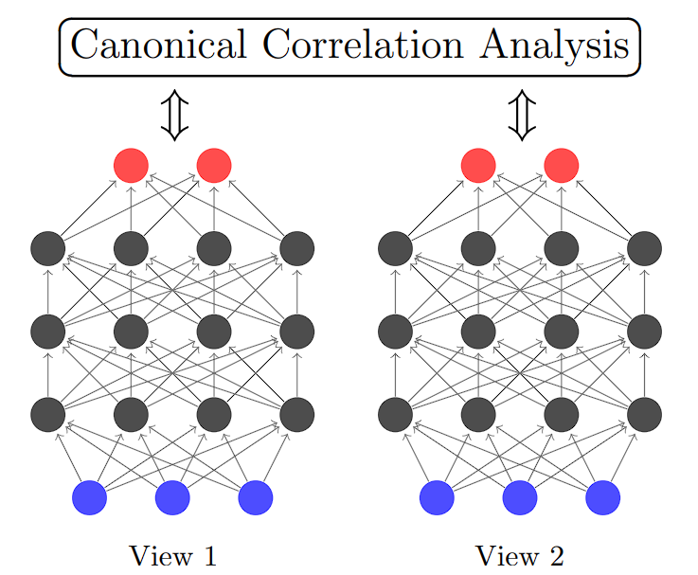
Deep Canonical Correlation Analysis (DCCA)

Slide 8
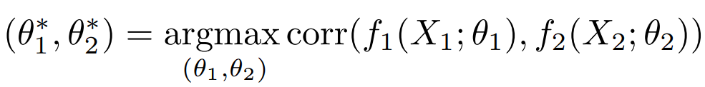
Deep Canonical Correlation Analysis (DCCA)

Slide 9


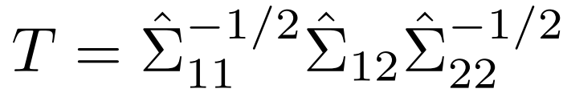
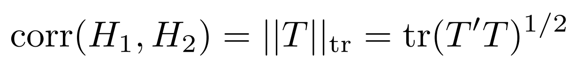
Deep Canonical Correlation Analysis (DCCA)

Slide 10
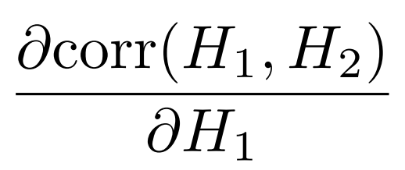
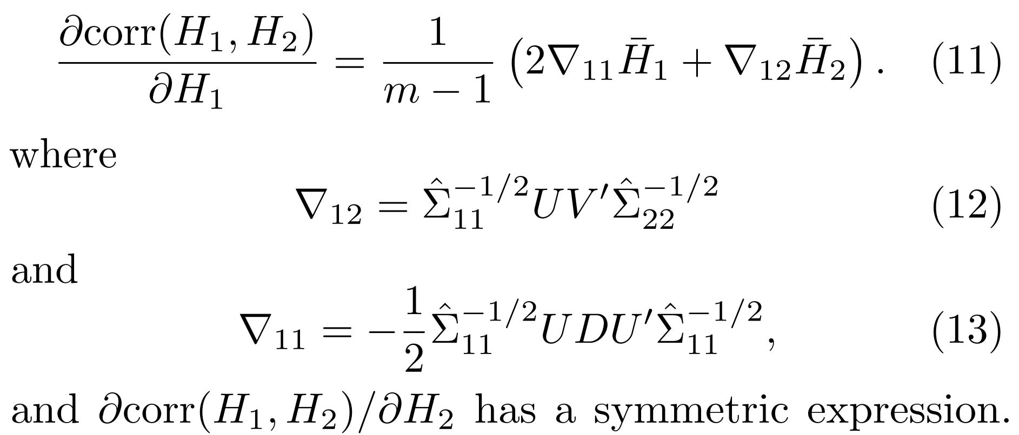
Deep Canonical Correlation Analysis (DCCA)
To use backpropagation, we need to compute the gradient of the correlation, especially,

Slide 11

Deep Canonical Correlation Analysis (DCCA)
Regularization with a quadratic penalty
L-BFGS second-order optimization method (Nocedal & Wright, 2006)
Initialize the parameters of each layer with a denoising autoencoder
Usage of a novel activation function: Inverse of

Slide 12
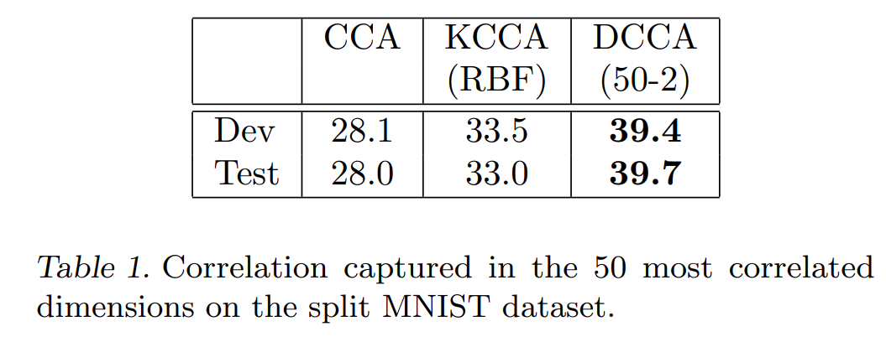
Experiments

Slide 13
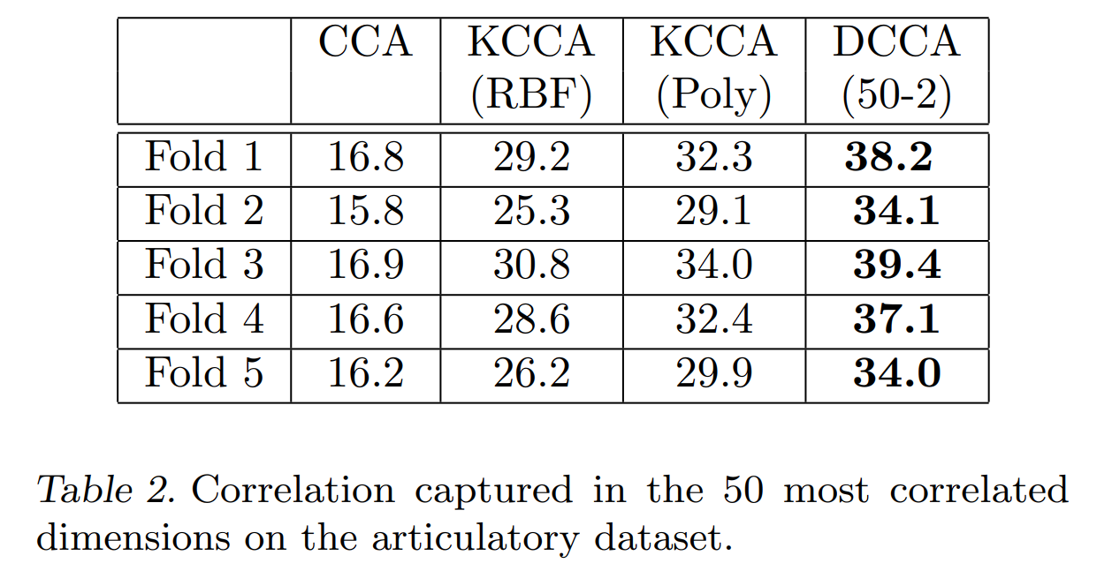
Experiments

Slide 14
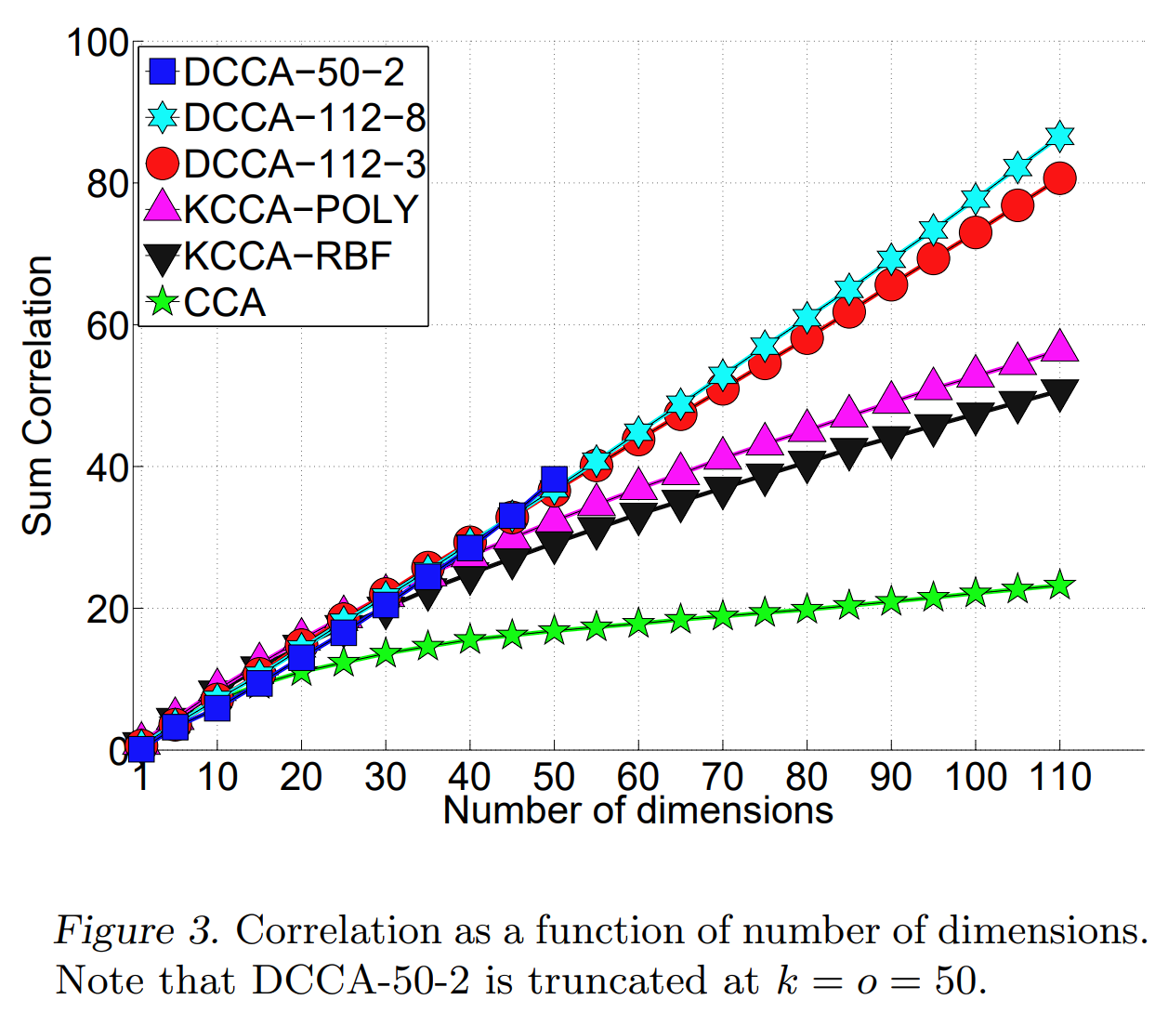
Experiments

Slide 15


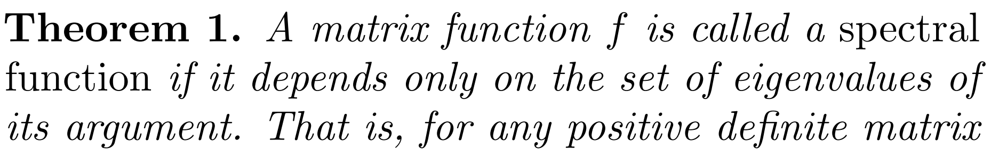
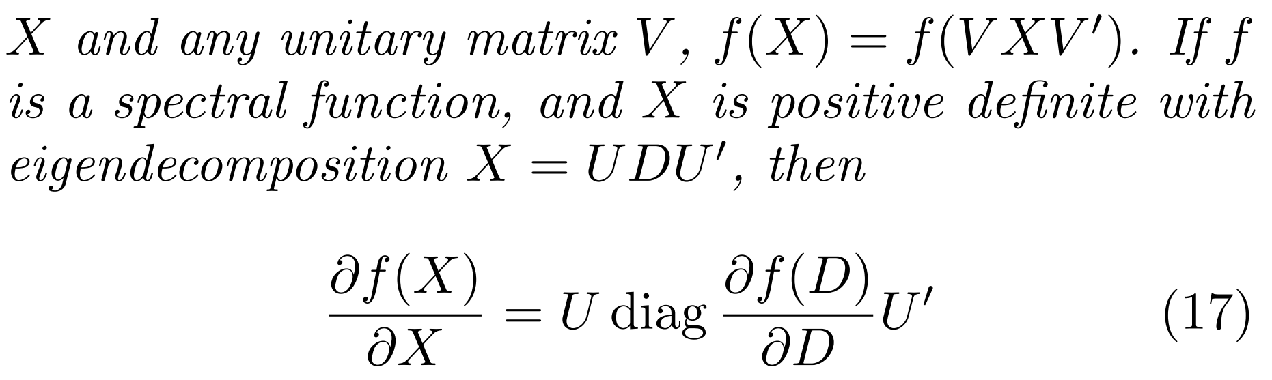
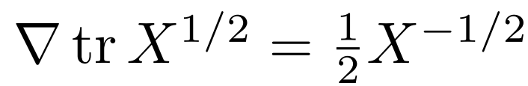
Appendix
For a matrix ,
(Application)

